Slide 1

FY25 Financial Report
(July 2024 - June 2025)
Notes:
Hello. I am presenting a financial summary of the DDI Alliance for Fiscal Year 2025 (that is, July 2024 through June 2025), including what was budgeted, what is forecasted, and key strategic insights as we close in on year-end.”

Slide 2
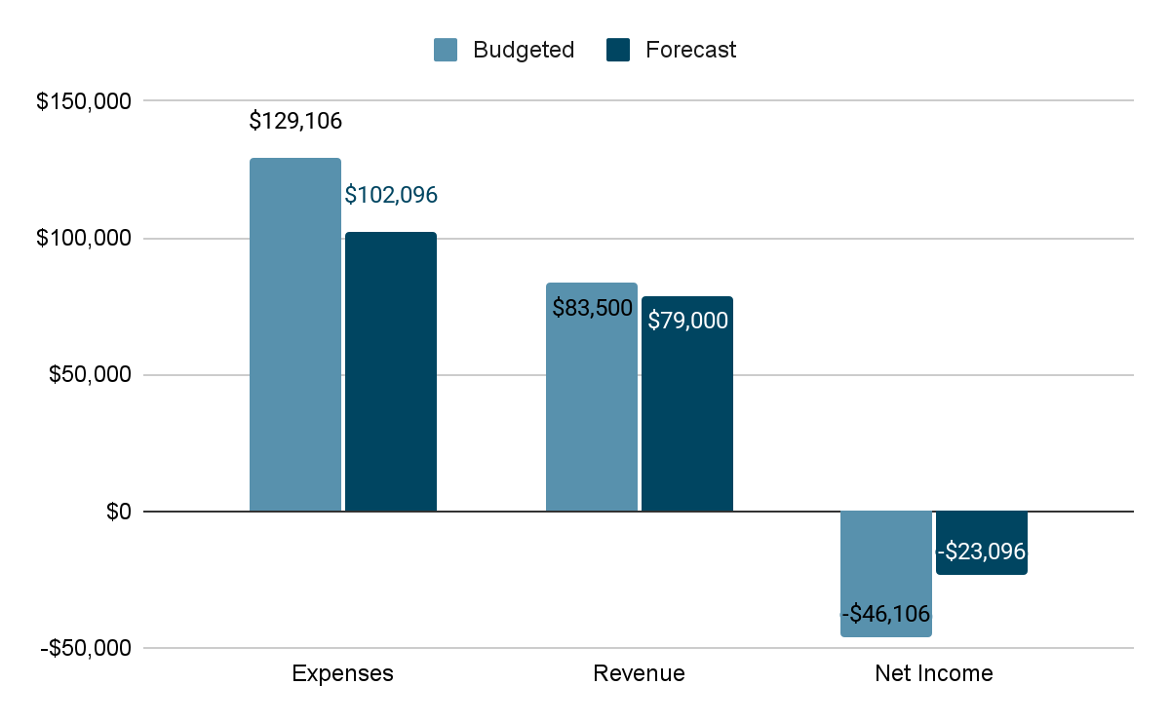
FY25 Budget Overview
Currency in USD
Notes:
We began the year with an Executive Board-approved budget of about $129,000 US dollars. As of the most recent reconciliation, we forecast we’ll spend approximately $102,000, putting us around 79% of the budgeted amount.
We’ve collected $79,000 in revenue -- slightly under the budgeted amount.
Net income is forecasted to be a loss of about $23,000, nearly half the budgeted amount.

Slide 3
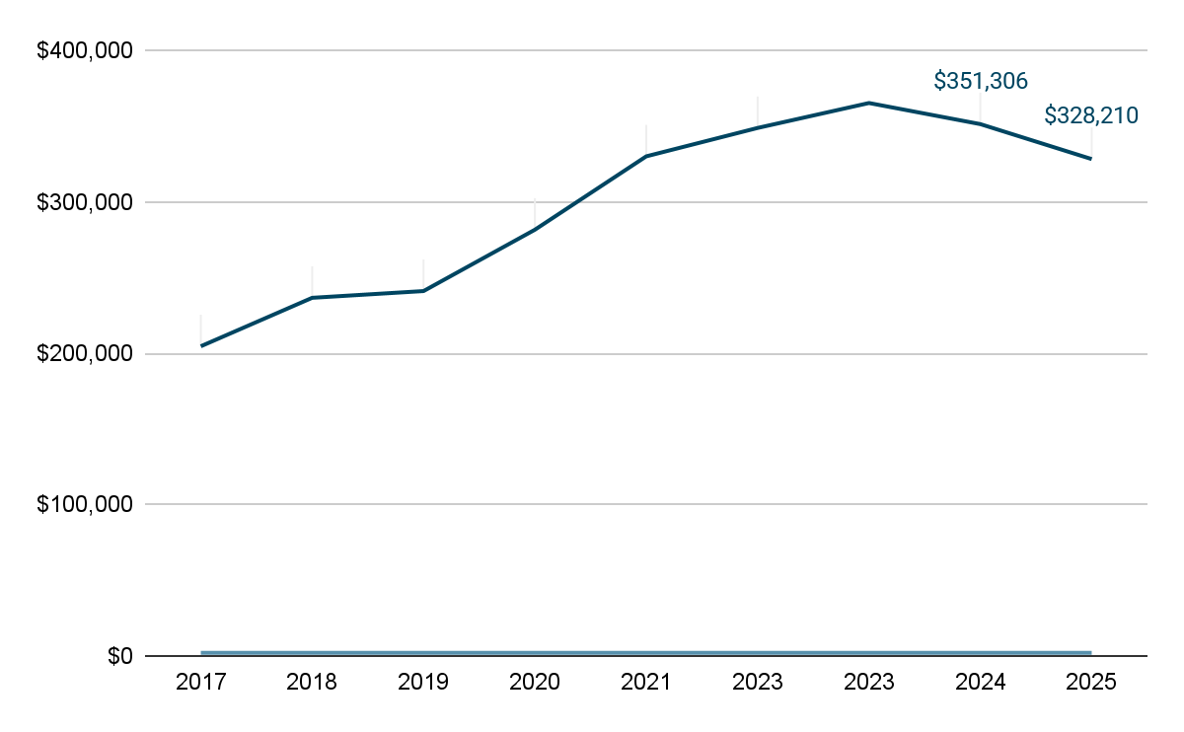
Reserves Balance
Currency in USD
Notes:
Here’s the big picture: We started the fiscal year with a strong balance of $351,000. After accounting for forecasted expenses, our current projected fund balance is $328,000. This decline is less than expected and aligned with budgeted activity. We remain in a solid financial position.

Slide 4
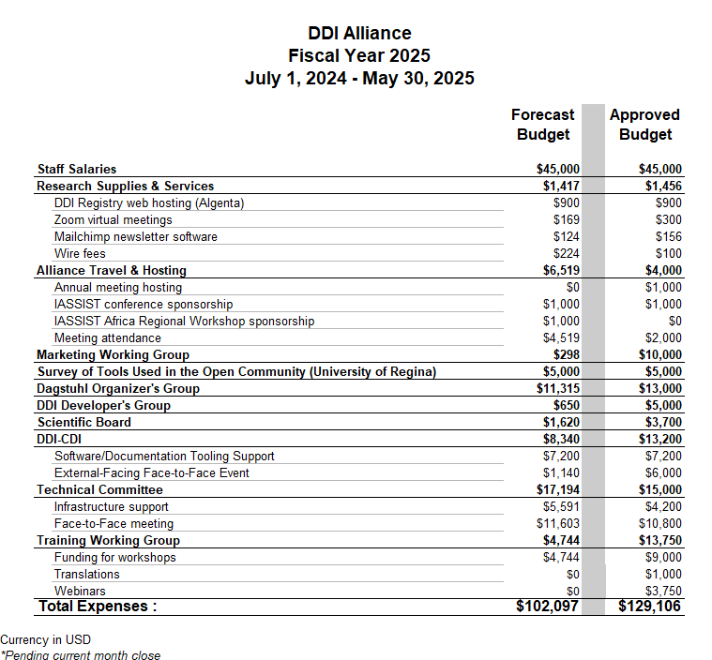
Notes:
Here is a detailed look at the Alliance’s expenses for this fiscal year, including what was approved and what we forecast to spend by the end of this June.
This includes significant budgets allocated to the different working groups, like Marketing, DDI-CDI, Training working groups, as well as the Technical Committee.

Slide 5
Noteworthy mentions
Alliance Travel & Hosting exceeded its allocated budget due to unexpected travel to the IASSIST Africa Regional Conference and ISO Meetings.
Developer’s, DDI-CDI, Marketing, and Training Working Groups both have significant unspent funds.
Notes:
There are a few deviations worth noting. Alliance Travel & Hosting exceeded its allocated budget due to unexpected travel to the IASSIST Africa Regional Conference and ISO meetings.
On the other hand, several groups—including Marketing, Training, and DDI-CDI—have significant unspent funds.

Slide 6
Questions?
Notes:
Looking forward, our goal is to align our resources with strategy—supporting innovation, member engagement, and long-term sustainability. In the next presentation, Jon will outline a proposed three-year budget to support DDI’s evolving role in the data standards community.
I’m happy to take any questions. Thank you.

